Slide 1

Texting Team Training

Slide 2

Mission of the Texting Team
Humanity First
Make America Think Harder
Identify, recruit, inform and mobilize Yang supporters
Three main types of texts:
Voter Identification
Event Invites
Fundraising

Slide 3
Getting Started
We use two platforms to send texts and communicate
Spoke
Peer-to-peer texting platform
Web-based
Texting hours are 12pm - 9pm ET
Slack
Team communications

Slide 4
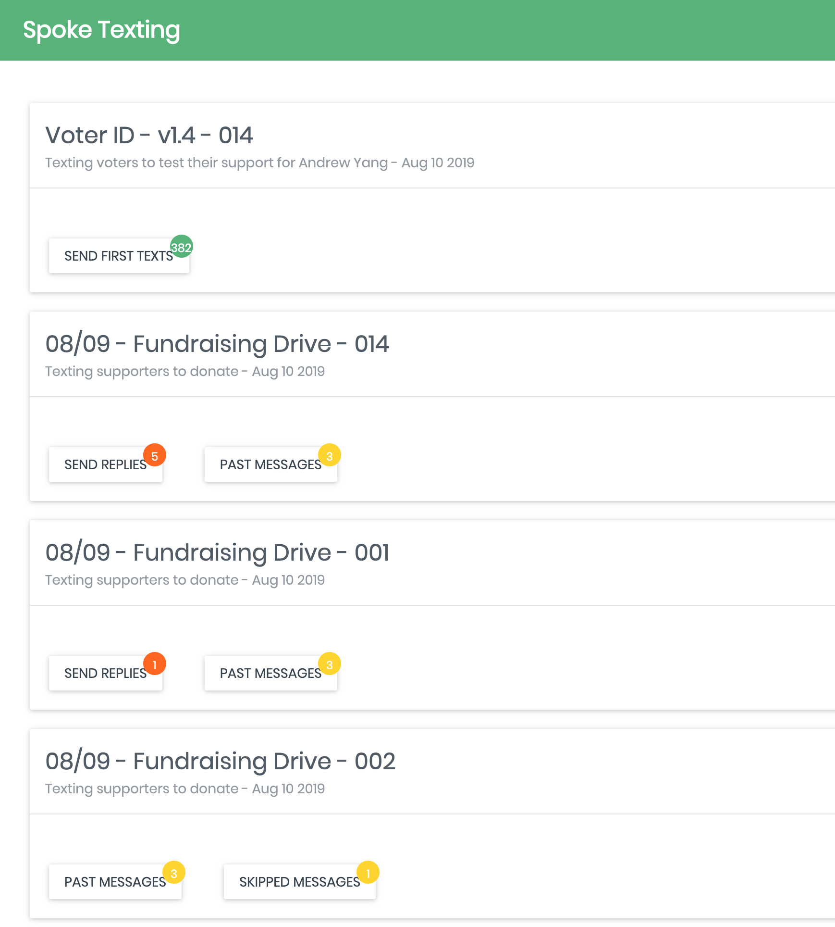
Spoke - Dashboard
Notes:
Dashboard

Slide 5
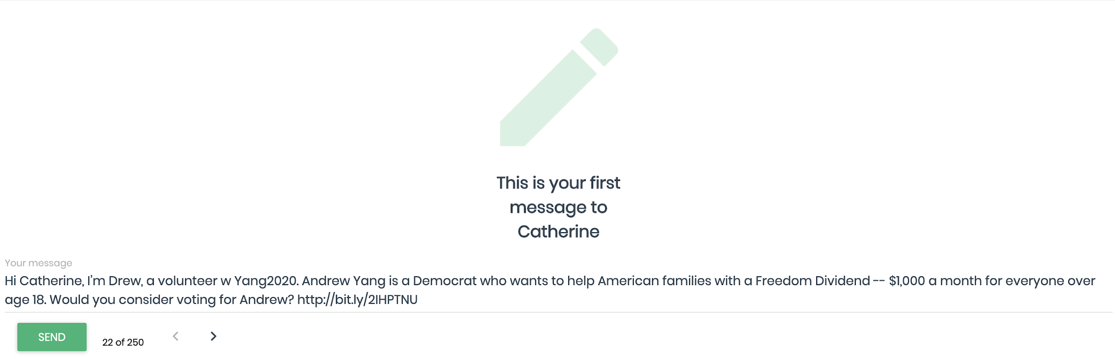
Spoke - Initial Message
Notes:
Initial messages
Send all initial messages before replying
Have to physically click to send each message

Slide 6
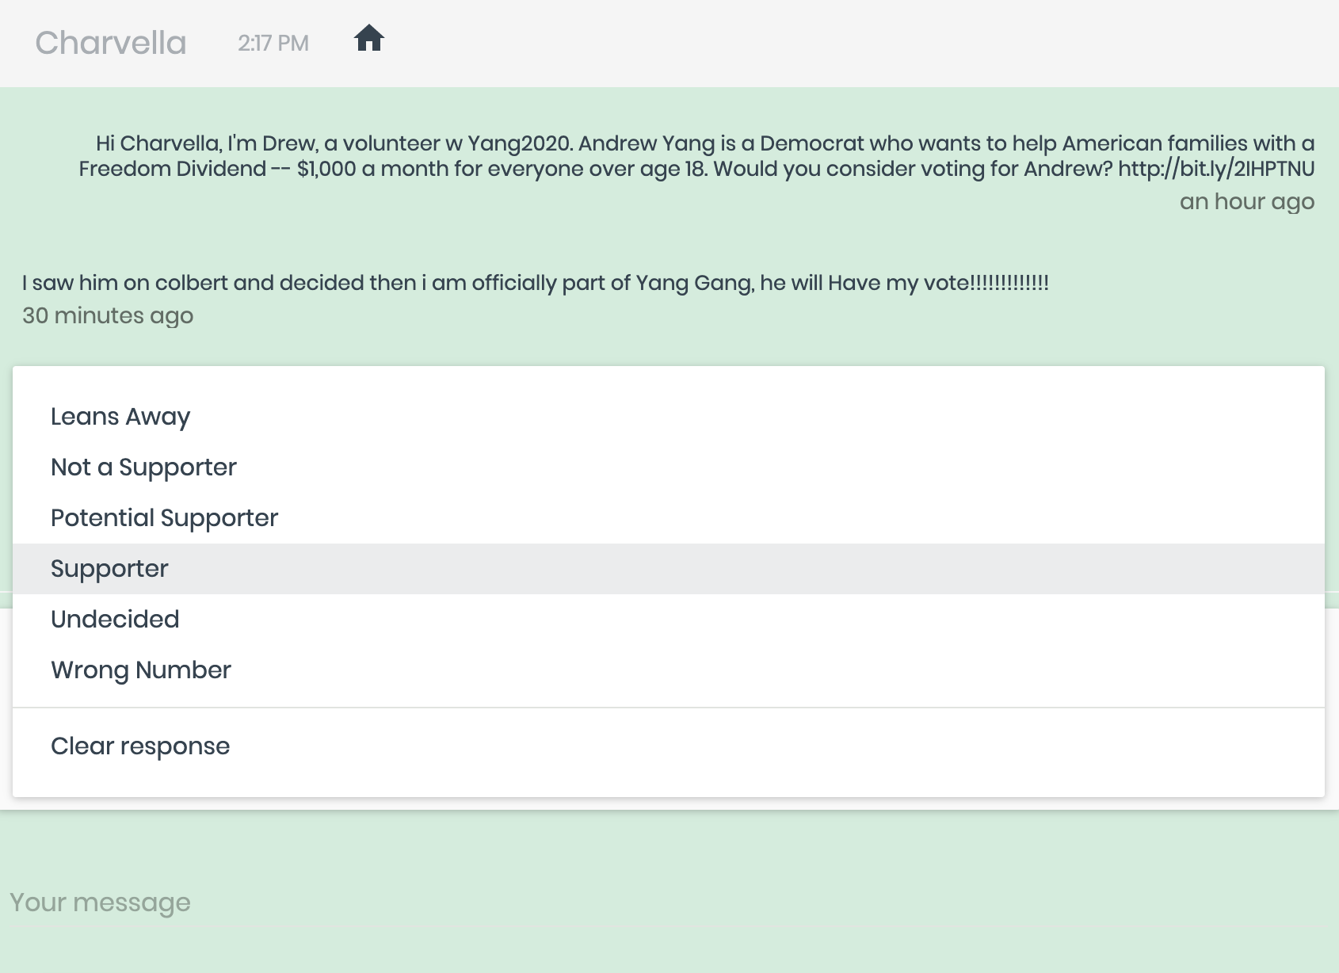
Spoke - Canned Responses

Slide 7
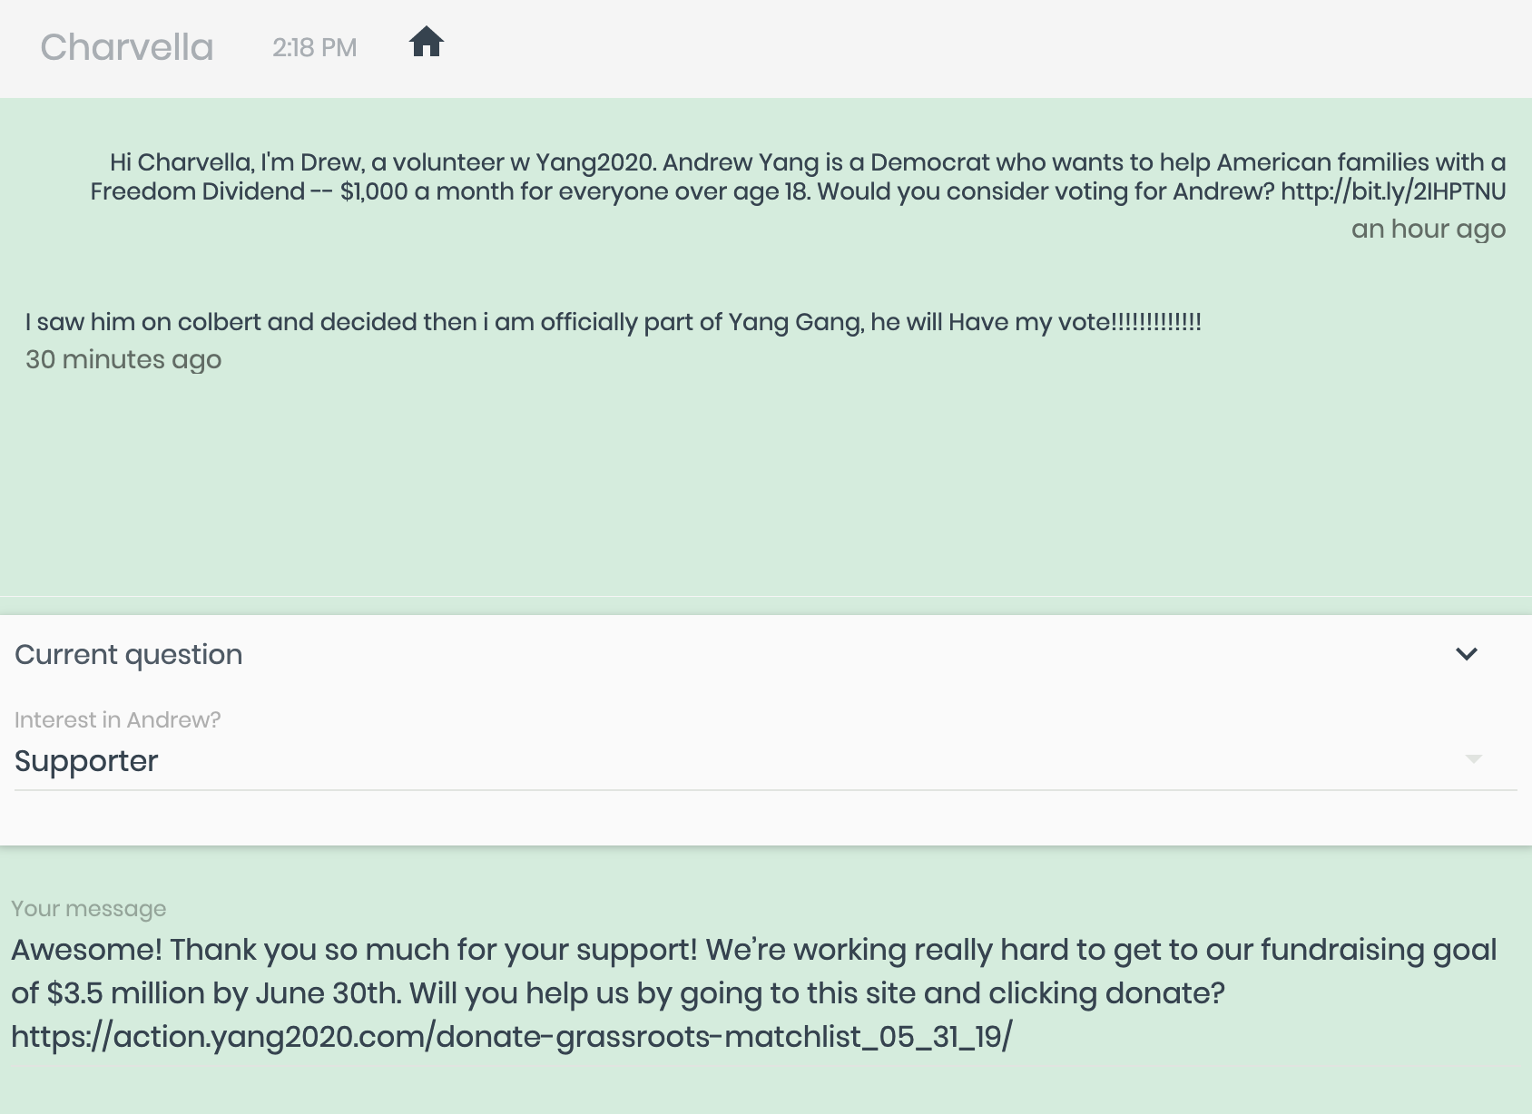
Spoke - Canned Responses

Slide 8
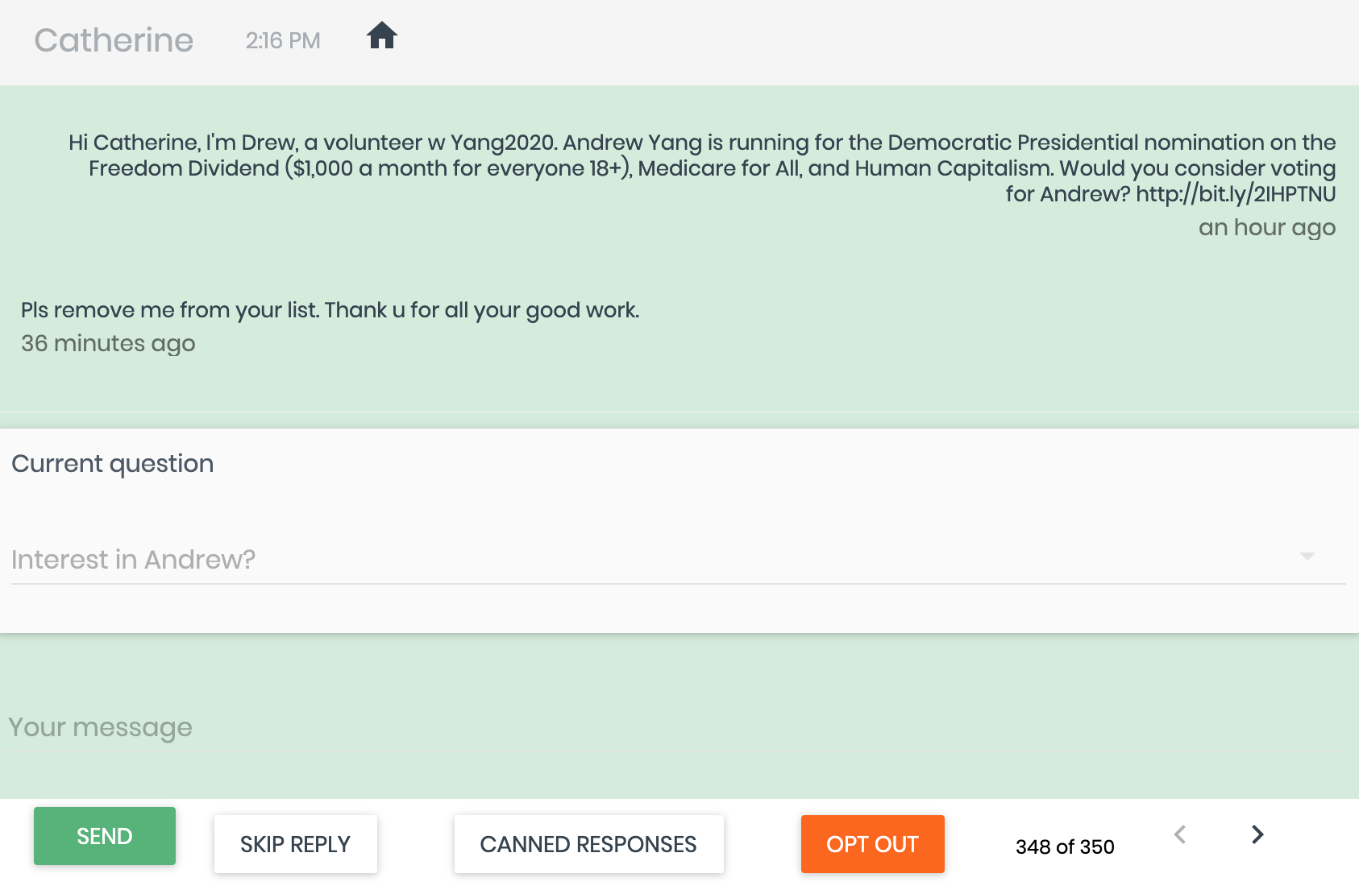
Spoke - Opt Out

Slide 9
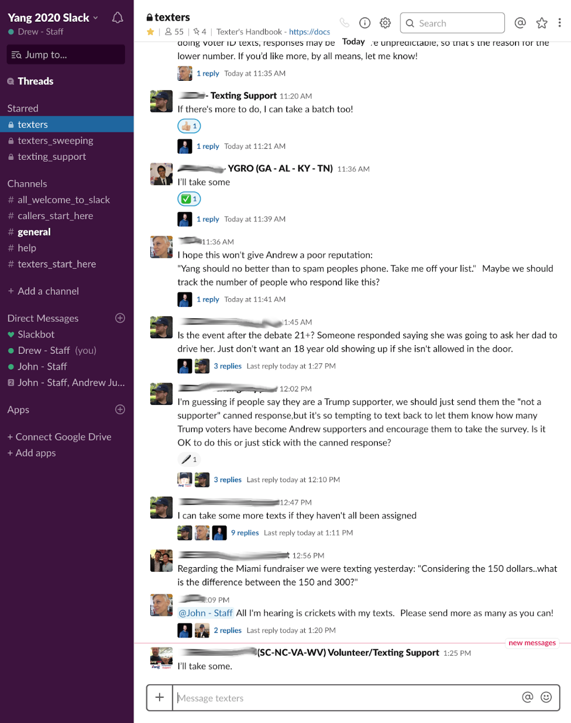
Slack
Slack is the exclusive way to communicate with the Texting Team.
Request texts
Get updates
Ask questions

Slide 10
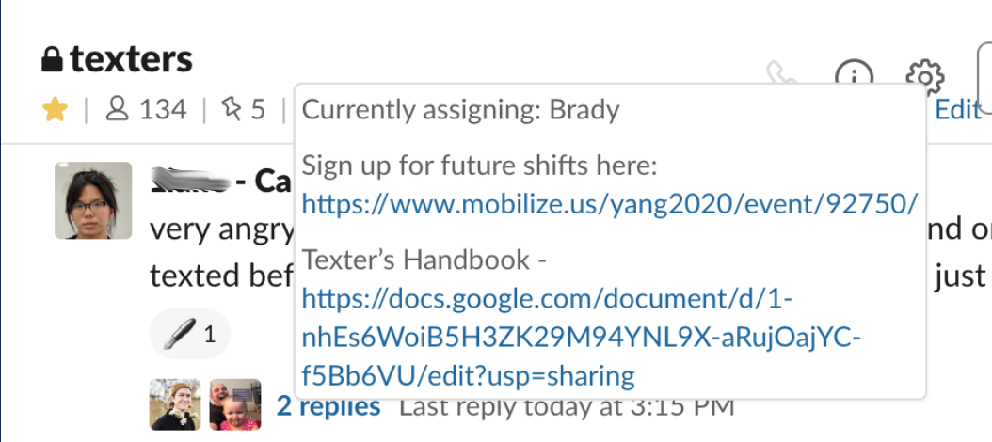
Slack
When logging into Slack, check the channel status by hovering your mouse over it at the top of the channel. This will indicate who is currently assigning, and relay any important information about the day’s campaigns.

Slide 11
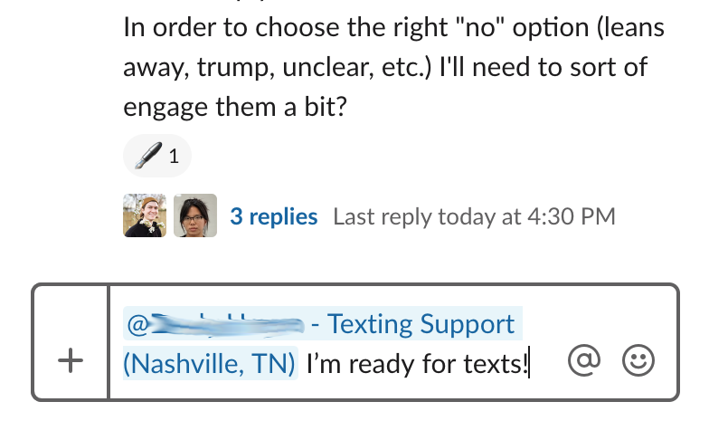
Slack
When you’re ready for some texts, tag the current assigner by typing “@” and their username, and let them know you’re ready
They will assign a batch of texts to you and reply to your post when they’re assigned

Slide 12
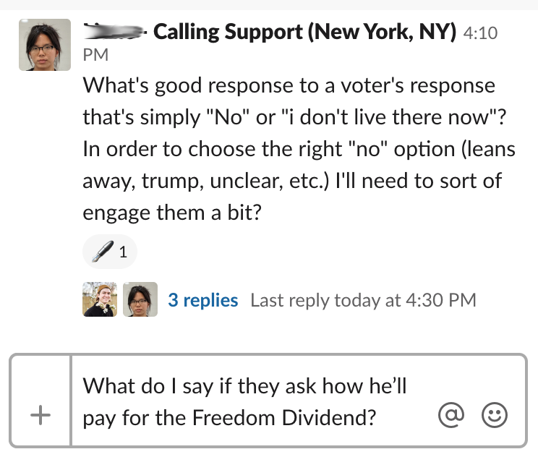
Slack
If you have a question about how to respond to a question or how to mark a response, ask in the #texters channel

Slide 13
Code of Conduct
Be a Good Guest: No arguing or disrespect
We say good things about our candidate, not bad things about other candidates
Stay Positive!
Wrong numbers always take precedent
Report threats and abusive messages to staff or volunteer managers

Slide 14
Code of Conduct
Opt-Out Requests
If they want to be opted out, do it. If they don’t mention it, don’t
YES Opt Out: Stop, unsubscribe, quit, go away, don’t text me
NO Opt Out: Wrong number, #MAGA, I support someone else, you text too much

Slide 15
Code of Conduct
Texts are Forever: What would your message look like out of context on CNN?
Represent Yang’s positions accurately
Let Andrew Speak for Himself: use the website, quotes from Andrew, or make it clear you’re speaking for yourself
Personalize the Responses: You can and should do minor editing for conversation flow

Slide 16
Code of Conduct
No Data > Bad Data: Do not read into text responses
Always report double texting
Follow Security Rules
Follow the naming conventions
Use the same email for your Slack account and your Spoke account.

Slide 18
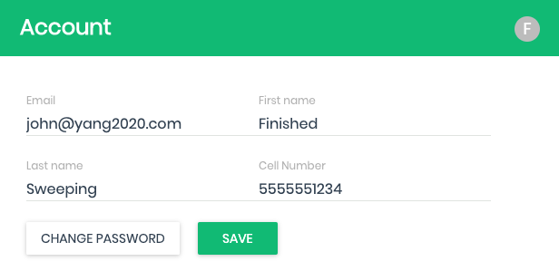
Take the Quiz!
Visit yang2020.com/textingquiz to agree to the Code of Conduct and take the quiz!
Keep an eye on your email inbox (check for spam - email will come from drew@yang2020.com)

